Slide 1


Slide 2
Anomalies in Database Design
Anomalies are the different problems that arises during
the maintenance of the Database.
There are three types of anomalies:
1. Insertion Anomaly
2. Deletion Anomaly
3. Modification Anomaly

Slide 3
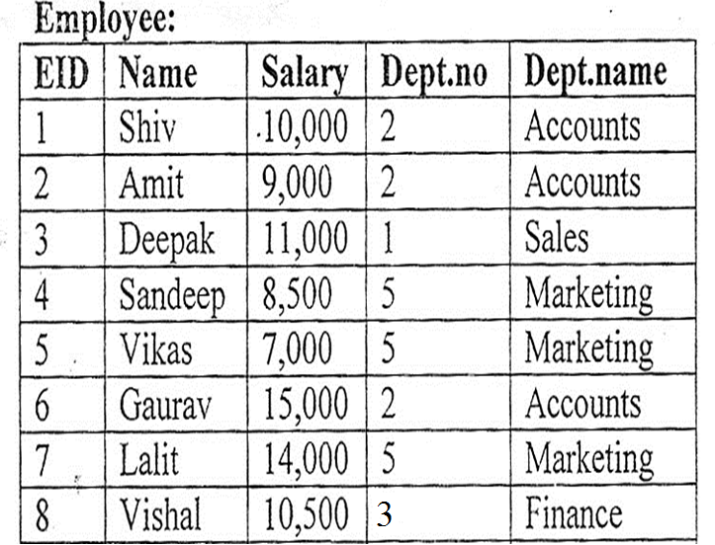

Slide 4
EID is the PK here.
Here if we want to enter a new department but not new employees,
then anomaly occurs.

Slide 5
Modification Anomaly: This occurs when we try to update any existing
information and that causes inconsistency in the relation.
This is modification anomaly.

Slide 6
Deletion Anomaly: It occurs when we try to delete any information
that causes the loss of any other desirable information.
This is deletion anomaly.
If Deepak’s information is required to be deleted then the Sales
dept details will also be deleted.

Slide 7
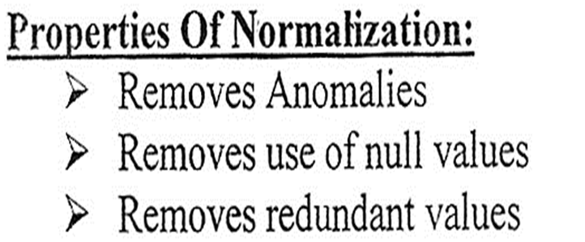
DEFINITION:
Normalization is a process by which we can
decompose any relation into more than one relation to remove
anomalies in database. It is a step by step process & each step
is known as Normal Form.

Slide 8
Various Normal Forms
1NF
2NF
3NF
BOYCE CODD NORMAL FORM(BCNF)
4NF
5NF
6NF

Slide 9
1NF
A table is said to be in 1NF, if it contains all atomic attributes.
Simple and Single valued attributes are called Atomic Attributes.
1NF removes the repeating or redundant data from a table.

Slide 10
TABLE A
Roll _Number | Name | Phone _Number | Age
1 | Amit Ghosh | 22567892 | 21
1 | Amit Ghosh | 9831678234 | 21
2 | Sumit Paul | 23456734 | 23
In table A lots of redundancies are there like Name , Roll Number,
Age.
There exists Composite Attribute Name and Multivalued Attribute
Phone Number.
So table A is not in 1NF or is in Un-normalized Form.

Slide 11
TABLE B
Roll _Number | First_Name | Last_Name | Age
1 | Amit | Ghosh | 21
2 | Sumit | Paul | 23
TABLE B1
Roll_Number | Phone_Number
1 | 22567892
1 | 9831678234
2 | 23456734
In the table B and B1 , there are less number of redundancies as
comparison to table A.
Also, all the attributes are simple and single valued. Hence atomic
attributes are present.
So the table B is in 1NF.

